Slide 1
Unit 5.
CONSERVATION DIAGNOSTICS: Habitat

Slide 2
Unit 5. CONSERVATION DIAGNOSTICS: Habitat
Habitat study.
Models.
Experimental design.
Manipulative experiments.
Observational experiments.
Multivariate analysis.
Habitat loss and fragmentation.
Patterns in the fragmented habitat.
Edge effect.

Slide 3
1. Habitat study
Knowing the proper conditions for the observation of the species has probably been one of the first elements of human cultural transmission.
This knowledge of animals and plants has been transmitted from generation to generation.
In this way, knowledge on soil characteristics, vegetation type, orography, climatic conditions, water quality, etc. was a highly valuable information.
What were these people doing when they pass on this information?
They described the habitat of a given species.

Slide 4
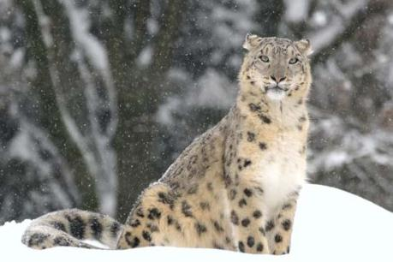
1. Habitat study
The zoologist George Schaller and his chronicler Peter Matthiessen are searching for the elusive snow leopards (Uncia uncia) on Earth Dolpo through their prey, Himalayan blue sheep (Pseudois nayaur).
1971 Eugen Odum defines the habitat of the species as "the place where you go to find them."

Slide 5
1. Habitat study
Isoetaceae
Terrestrial
(with filopodes)
Isoetes histrix (the most frequent, not endangered)
Isoetes durieui (VU: vulnerable)
Anphibian
(wothout filopodes)
Isoetes setaceum (VU: vulnerable)
Isoetes velatum subsp. velatum (DD: deficent data)
In acid soils, with some edaphic moisture and ponds.

Slide 6
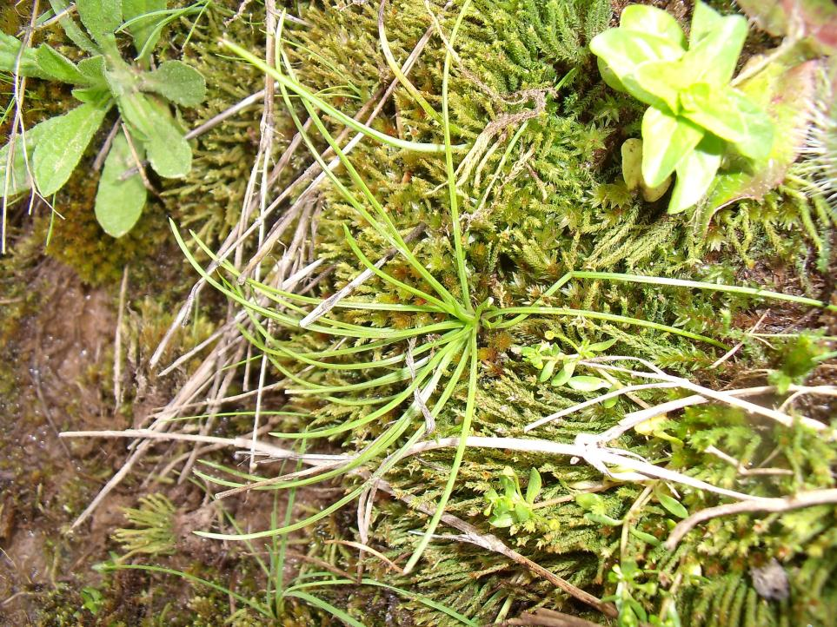
Isoetes histrix

Slide 7
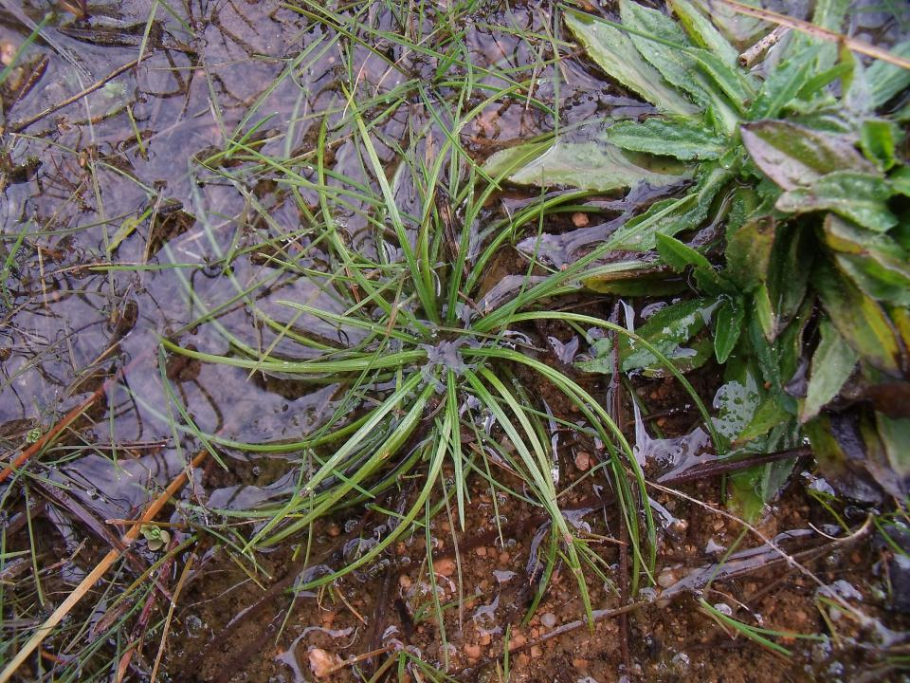
Isoetes histrix

Slide 8
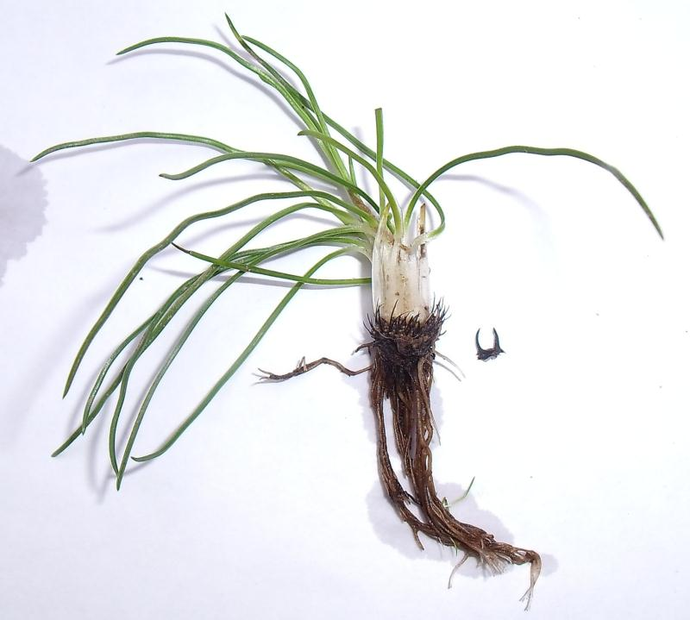
Isoetes histrix

Slide 9
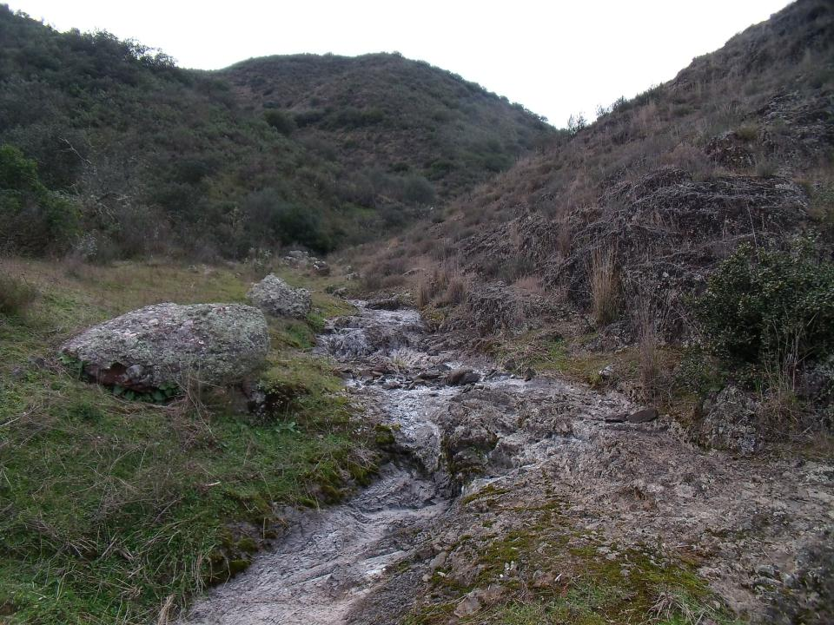
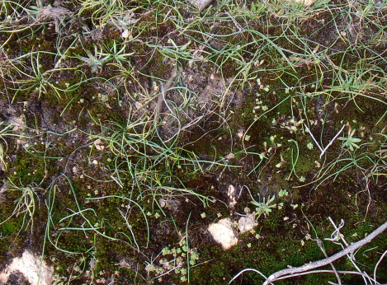
Isoetes histrix

Slide 10
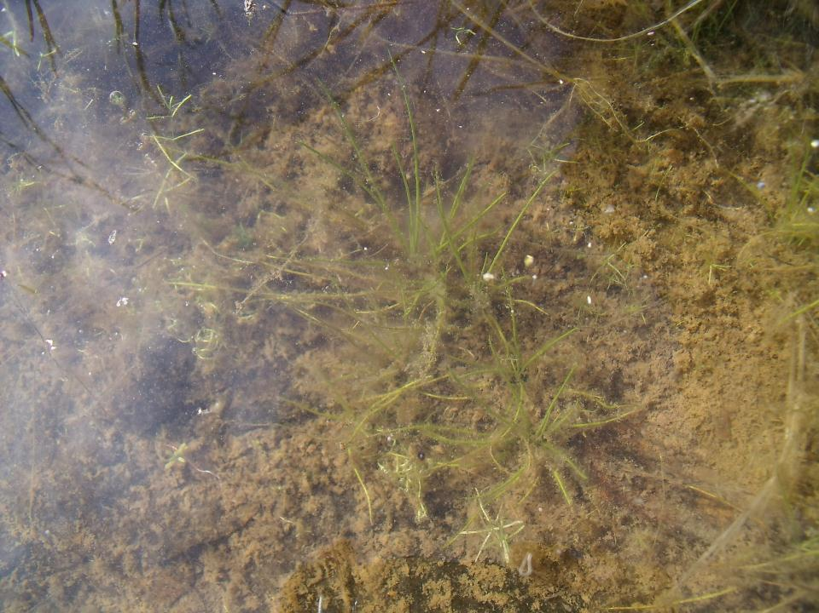
Isoetes velatum subsp. velatum

Slide 11
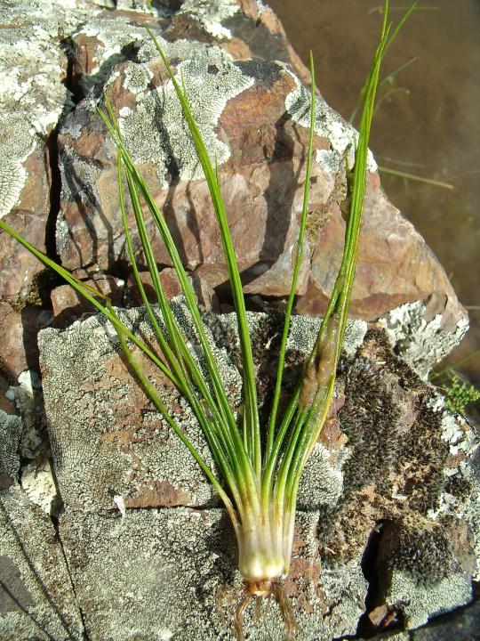
Isoetes velatum
subsp. velatum

Slide 12
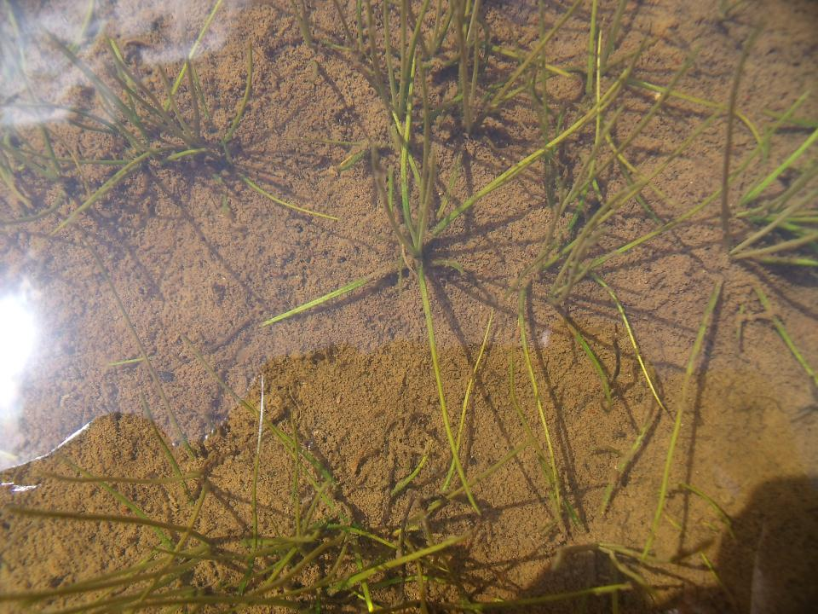
Isoetes setaceum

Slide 13
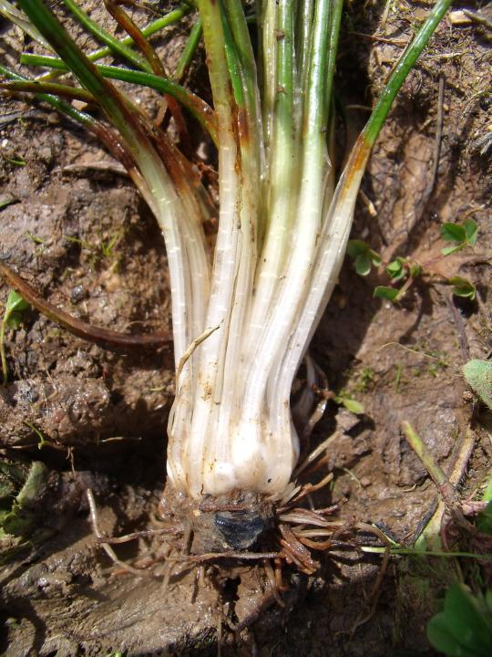
Isoetes
setaceum

Slide 14
1. Habitat study
Definition of habitat: area in which there are appropriate conditions for living an organism, plant or animal species or community.
A good knowledge of the habitat is basic to any in-situ strategy with conservationist purposes.
Only in this way they can be identified first and then try to correct the processes that negatively could affect populations.
The study of habitat usually starts from purely descriptive approaches.
It seeks to know the distribution patterns of the species based on certain environmental gradients.

Slide 15
1. Habitat study
Therefore, the study of the habitat reflects the existence of more or less suitable areas for a given population or species.
The study of the habitat itself does not serve to understand what happens in the ecosystem.
In this way, the description of the distribution patterns of the species will lead us to investigate the processes that generate them. How?
Analyzing the response of the population to certain environmental features.
Analyzing the reaction to disturbances originated by human activities.

Slide 16
2. Models
The application of scientific method to study the habitat of the species involves the development of Models.
These can be defined as "the representation of a part of the real world."
The ecological niche models study the species from many variables that influence them.
There are two types of variables:
Climatic
Independent or explanatory variables
Topographical
Edaphological
Biotic
Abundance of individuals, etc.
Dependent variables
Body condition, etc.
Recruitment (reproductive success), etc.

Slide 17
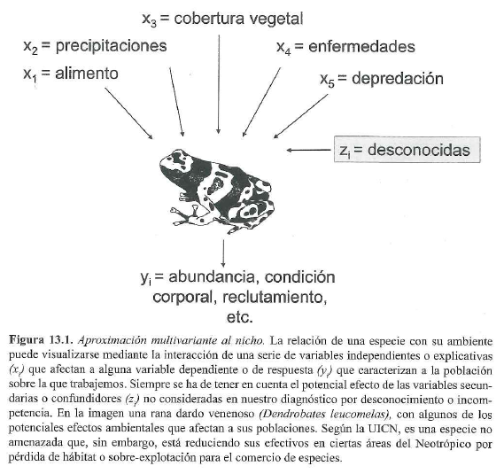
2. Models
VEGETATION
RAINFALL
ILNESSES
FOOD
PREDATION
UNKNOWN
ABUNDANCE, BODY CONDITION, RECRUITMENT, ETC..

Slide 18
3. Experimental design
The experimental design tries to corroborate the approaches that the scientist or researcher presumes.
To do this, the independent variables are used in order to check their effect or influence on the dependents.
To design an experiment it is necessary to select a series of sampling units:
Regions of a continent
Depending on the study area, the sampling units can be
Plots of a region
Individuals of a plot, etc...

Slide 19
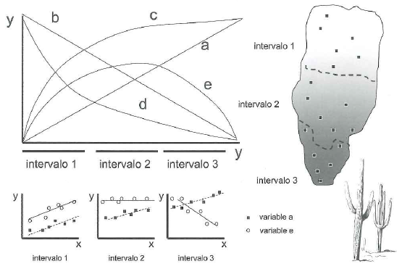
3. Experimental Design
Sampling units must meet four basic conditions:
1. Independent variables should not be constants, they should have variability.
2. The range of variation of the independent variables should be representative of the environment in which the studied species live. (ATTENTION: The species can response unevenly to the variables in places or times. See example).

Slide 20
3. Experimental Design
3. The selection of the sampling units should avoid the systematic action of secondary or confounder variables. (Unknown variables or scarcity of scientific knowledge. There are difficult to control, but you can try randomly selecting the location of the sampling units).
4. Avoid pseudoreplication, i.e. avoid using independent variables related among them (e.g.: temperature and distance to the sea are related variables).
Manipulative experiments
There are two types of
experimental designs
Observational experiments

Slide 21
3. Experimental Design
Manipulative experiments:
Developed in the laboratory under controlled variables.
It is easy to repeat.
The control of secondary variables is better.
Observational experiments:
Developed in the country.
They can consider historical records, traits of the species, etc.
They use the environmental variability.
Worst control of secondary variables.
Difficult to repeat because it is dependent on the natural cycles .

Slide 22
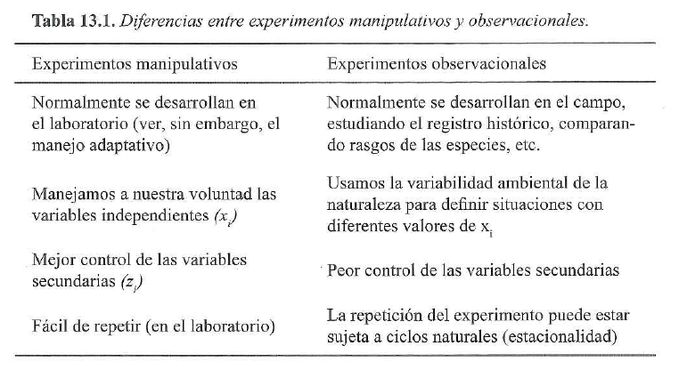
3. Experimental Design

Slide 23
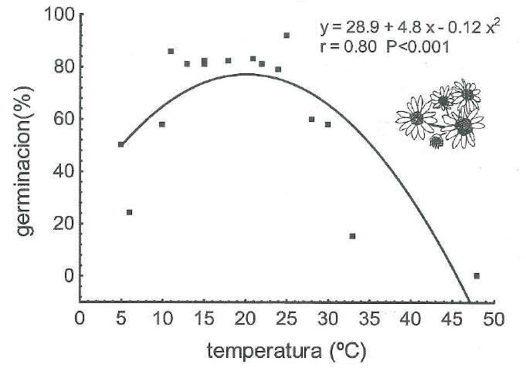
4. Manipulative experiments
Laboratory experiments generally where you can modify one of the independent variables to see how dependent variable responds.
Ex .: Change in weight of mice depending on the food.
Ex .: Germination of seeds depending on the temperature.
Senecio jacobaea (16 Petri dishes with moist sand covered seeds)
The seeds germinate badly in extreme conditions.

Slide 24
4. Manipulative experiments
There are also situations where you can develop manipulative field experiments.
E.g.: Study of harvesting of palm fruits (Euterpe oleracea) by Brazilian farmers to assess their effect on fruit-eating birds.
The presence of different birds in plots with different levels of fruit harvesting was controlled.
It was observed that some species were less sensible to a greater or lesser amount of fruits harvested and others were highly sensitive or could even disappear in the most exploited areas.

Slide 25
5. Observational experiments
They serve to develop a model of the relationships between dependent variables (e.g. presence or absence of a species) and independent variables (e.g. temperature, precipitation, pH, etc.).
They are based on the use of environmental heterogeneity of the territory to define gradients in which independent variables are manifested in a natural degree of variation.
There are two basic groups in the study of the species:
Availability vs. use
Multivariate analysis

Slide 26
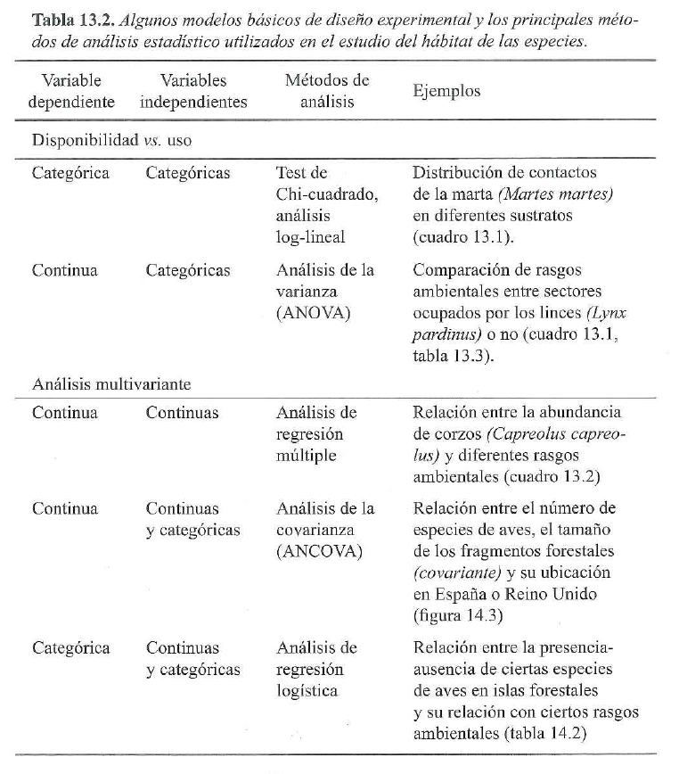
The categorical or qualitative variables can take qualities or categories as values. E.g.:
- Sex: H / M
- Health: Good / Fair / Bad
- Presence / absence
Continuous or quantitative variables take numerical values within an interval. They usually correspond with the independent variables. E.g .:
- Temperature
- Precipitation
- Evapotranspiration, etc.

Slide 27
6. Multivariate Analysis
It is useful for the development of models and to investigate the changes produced in a population due to the conjunction effect of different environmental variables.
An alternative is the logistic regression, in which the presence/absence of a species (0/1 value) with a series of continuous or categorical variables are related.
To carry out these analysis the following are necessary:
Geographic Information Systems (GIS).
Data independent and dependent variables.
Software for modelling.
Finally, suitability maps of the species are obtained.

Slide 28
7. Habitat loss and fragmentation
The quality of the habitat of the species is not distributed continuously, but varies with the climate, the substrate or the community of organisms with which they interact.
Therefore, the species are often distributed irregularly and discontinuously.
It can be said that there are two types of disturbances that promote the loss and fragmentation of the habitat:
Natural disturbances: landslides, volcanic activity, hurricanes, fires, etc.
Artificial disturbances promoted by the human being: crops and pastures, forest plantations, urbanized lands, reservoirs, communication routes, etc. It is one of the most frequent and ubiquitous threats to the conservation of biodiversity.

Slide 29
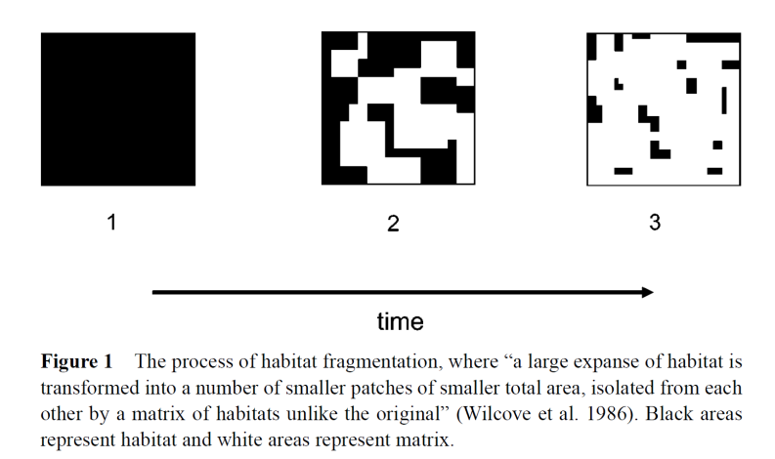
7. Habitat loss and fragmentation
Fahrig L. Annu. Rev. Ecol. Evol. Syst. 2003. 34:487–515

Slide 30
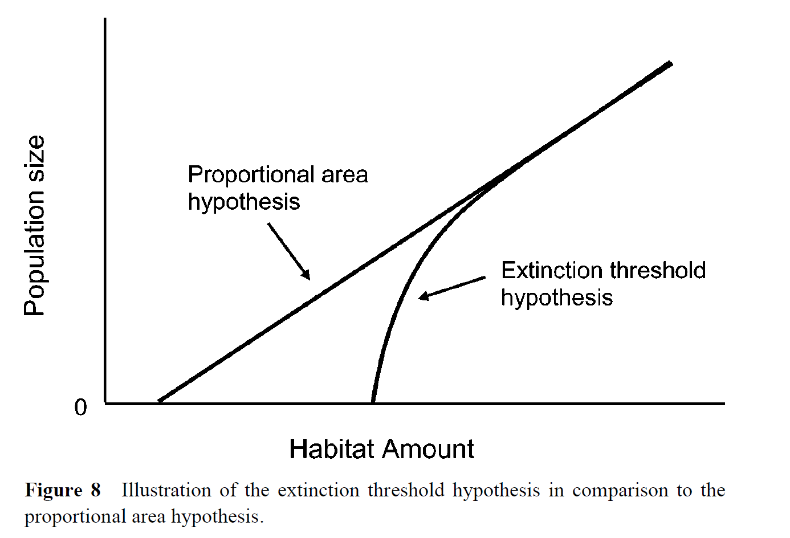
7. Habitat loss and fragmentation
La fragmentación supone una reducción del hábitat y aumento del efecto borde. La cantidad de hábitat no es proporcional al tamaño de la población. Cuando el hábitat se reduce aumenta el efecto borde y la cantidad de individuos que puede mantener se reduce exponencialmente (no proporcionalmente como cabría esperar).
Fahrig L. Annu. Rev. Ecol. Evol. Syst. 2003. 34:487–515

Slide 31
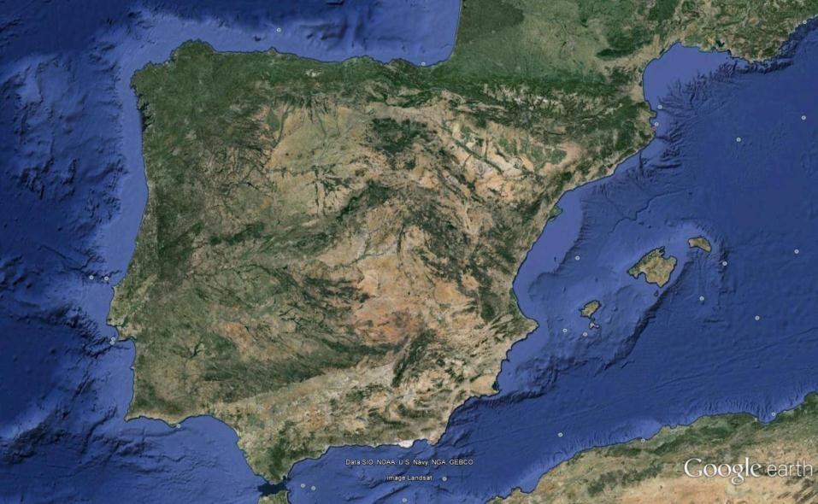
7. Habitat loss and fragmentation
Ancient deforestation (plateaus)
Ancient deforestation (plateaus)
Ancient deforestation (Ebro and Guadalquivier meadows)
Ancient deforestation (Ebro and Guadalquivier meadows)

Slide 32
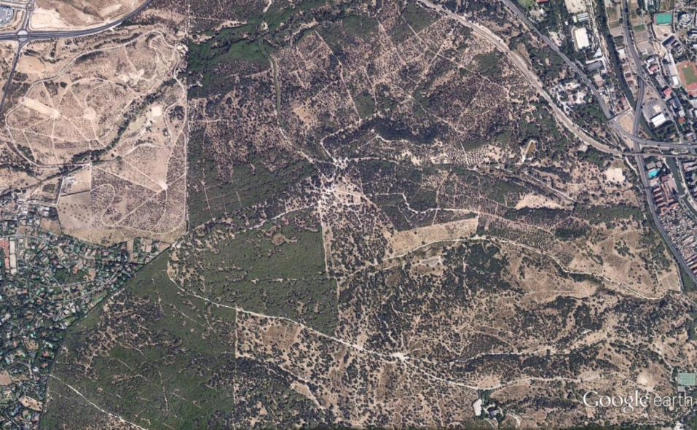
7. Habitat loss and fragmentation
Habitat lost
(crops or abandoned deforested areas)
Habitat lost
(urban fabric, roads, …)
Habitat transformation/conversion
(Pines, forest plantation, introduction)
Habitat lost or transformed?
(suburbs, residentials, …)
Rats, mouses, cockroachs,…
Habitat degradation
(original forest, Holm oak)

Slide 33
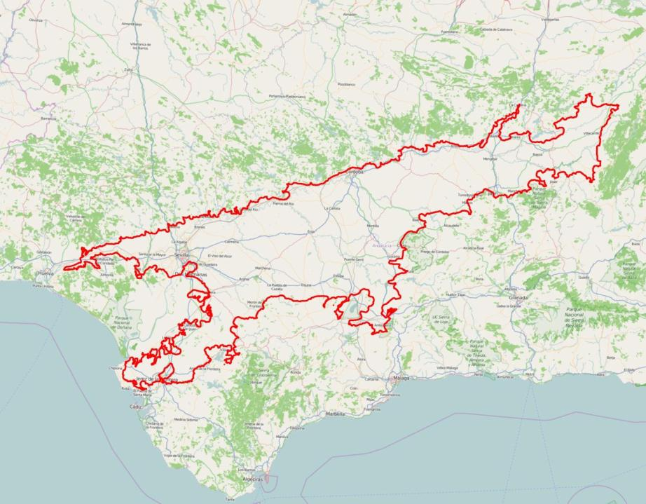
Research Project: Connectivity in the island forests (oaks) in the Guadalquivir meadow: a retrospective analysis.
Vega del Guadalquivir
(Ancient deforestation)

Slide 34
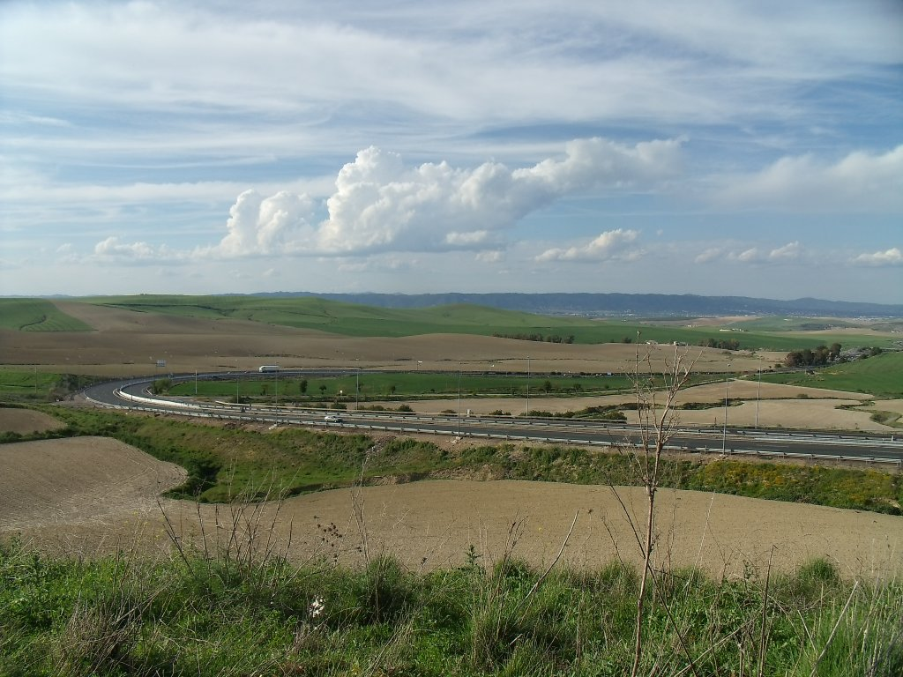
7. Habitat loss and fragmentation

Slide 35
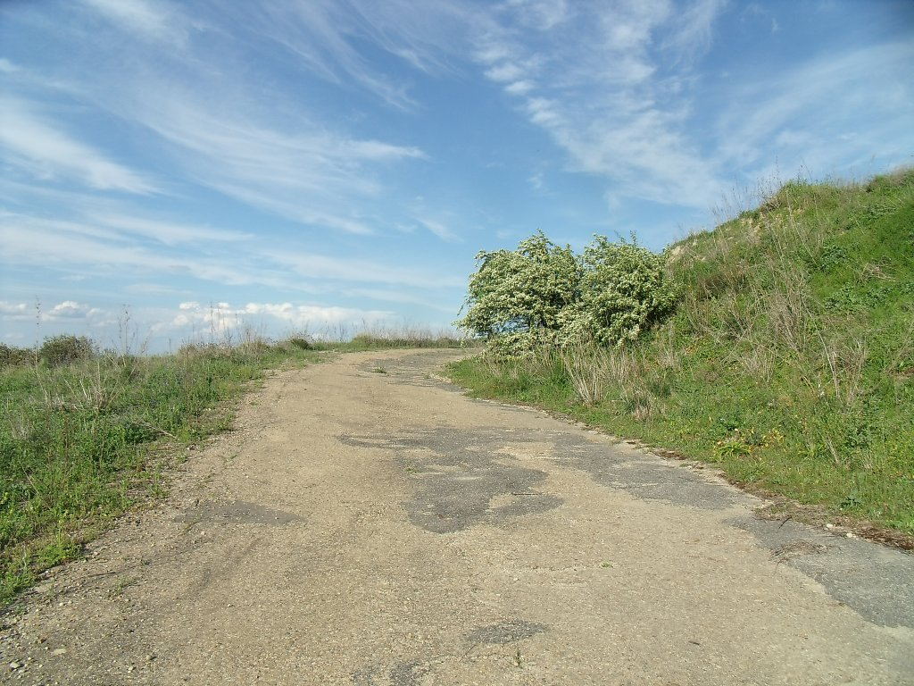
7. Habitat loss and fragmentation

Slide 36
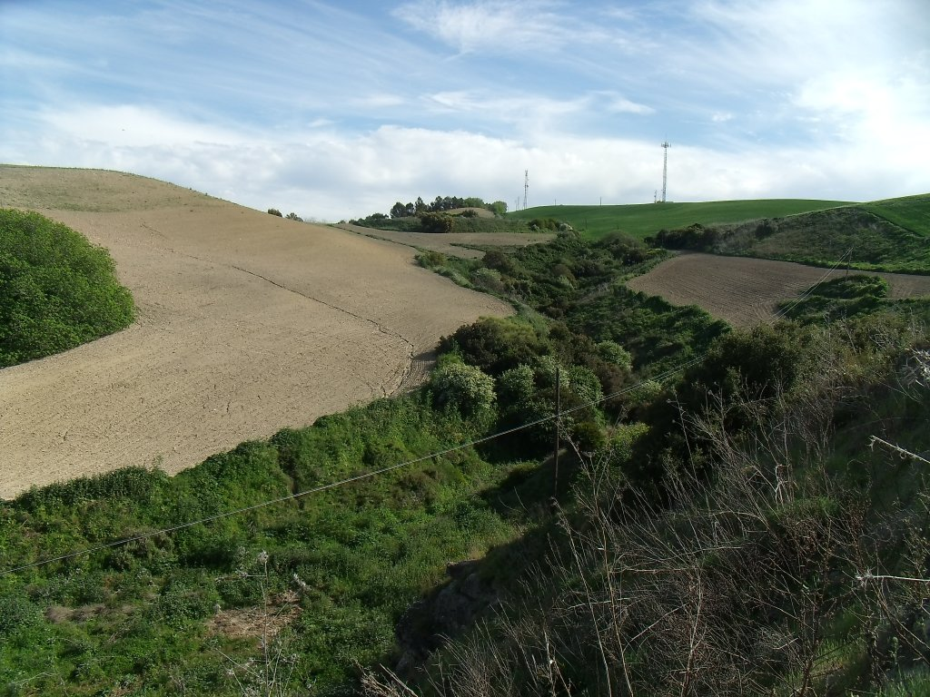
7. Habitat loss and fragmentation

Slide 37
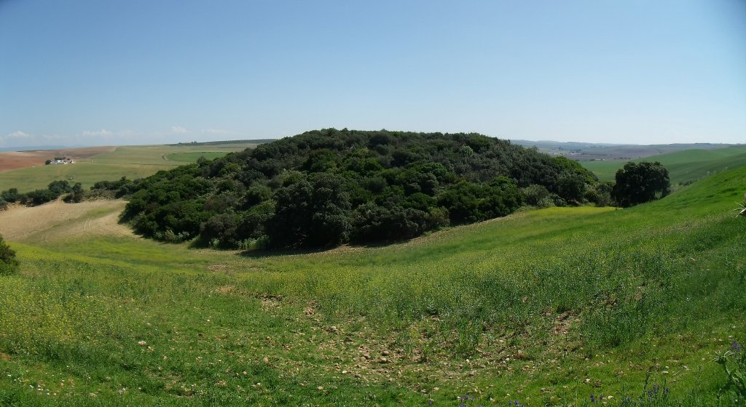
7. Habitat loss and fragmentation

Slide 38
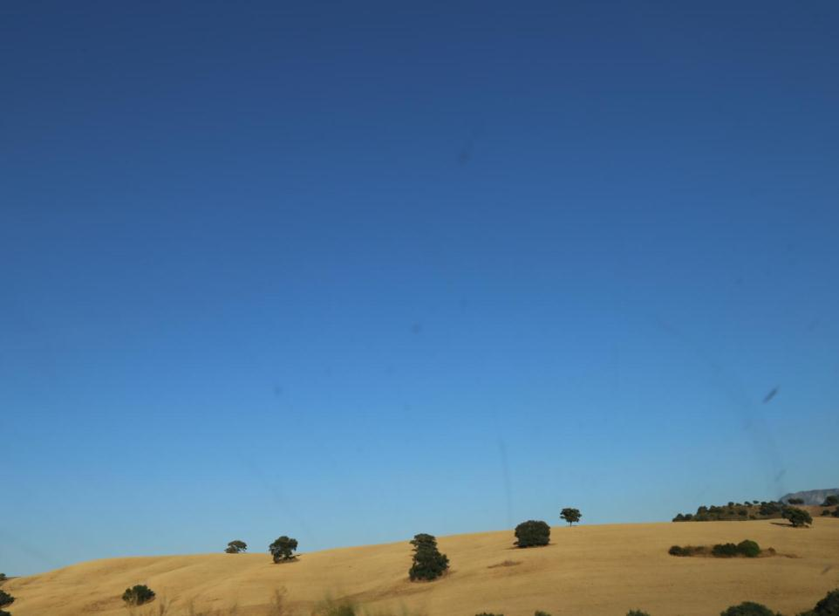
Island forests

Slide 39
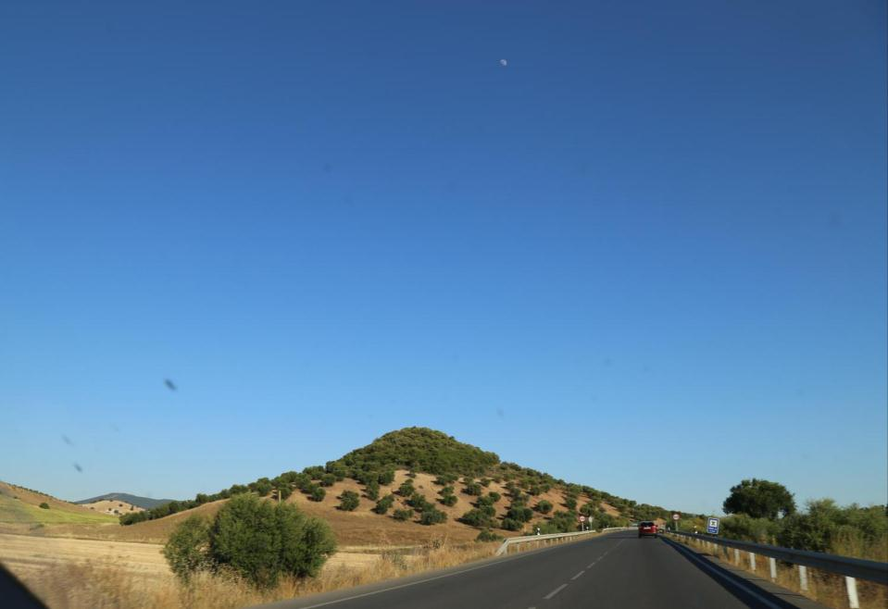
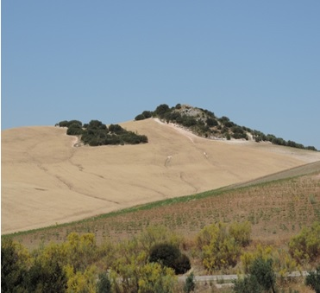
Island forests

Slide 40
8. Patterns in fragmented habitat
Observing the temporal evolution of a retreating habitat, four patterns are identified or detected:
1. Decrease in the area of habitat.
2. Decreased average size of the survivors fragments (island forests).
By below a certain threshold, the species in question will be unable to maintain their populations.
3. Increase in the distance between the fragments.
Thus increasing the difficulty of exchanging individuals between fragments.
4. Increased perimeter / area ratio (due to the pattern 2.).
Rising edge effect (interference between neighboring habitat).

Slide 41
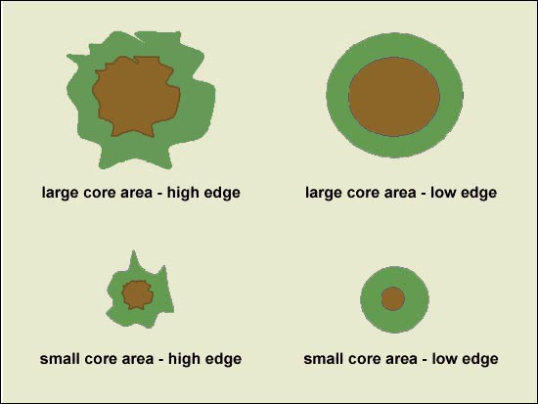
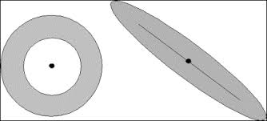
8. Patterns in fragmented habitat
http://www.madrimasd.org/blogs/universo/2008/06/29/95731
http://www2.inecc.gob.mx/publicaciones/libros/395/sanchez.html
Same area but different shape. By decreasing the size of the core, the edge effect is greatest.

Slide 42
8. Patterns in fragmented habitat

Slide 43
8. Patterns in fragmented habitat
Research Project: Connectivity of Mediterranean oak trees (holm-oak and cork-oak) in the Guadalquivir meadow: a retrospective analysis
Island forests | N. Poligons | Area (ha) | Mean area (ha) | Perimeter (m) | Mean perimeter (m)
1956 | 1.160 | 27.297 | 24 | 2.681.335 | 2.311
Present | 1.039 | 11.794 | 11 | 1.928.675 | 1.856
Change (%) | 10 | 57 | 52 | 28 | 20
60% of the island forests of the meadow have been lost in these 6 decades. The remaining polygons have lost more than 50% of area, although the perimeter has not been reduced in the same way (only 20%). Therefore, fragmentation and edge effect have increased.

Slide 44
9. Edge Effect
In ecology, edge effects are changes in population or community structures that occur at the boundary of habitats. Areas with small habitat fragments exhibit especially pronounced edge effects that may extend throughout the range.
http://www2.inecc.gob.mx/publicaciones/libros/395/sanchez.html

Slide 45
9. Edge Effect
Decreasing fragment size tends to increase the ratio perimeter/area.
It increases thus a ecotone (transition zones between natural habitats and altered areas) that can be harmful to the species that live in their habitat.
There are two possible types of processes affecting the survival of the species living in these fragments.
physical processes
biological processes

Slide 46
9. Edge Effect
Physical processes: Alteration of microclimatic conditions. Forests have a different microclimate than deforested areas, since the former retain moisture, project shade, attenuate wind and thermal oscillations, etc.
Thus, in the ecotone environmental conditions degrade and the edge effect can penetrate on average about 150 m, reaching in extreme cases several kilometers.
Edge effect can affect drastically and totally to small fragments.
Biological processes: The fragments reduction facilitates the entry of other species of the surrounding environments.
Increased generalist predators in the ecotone.
In addition, there may be changes in natural cycles of certain organisms (alteration in phenology for instance)

Slide 47
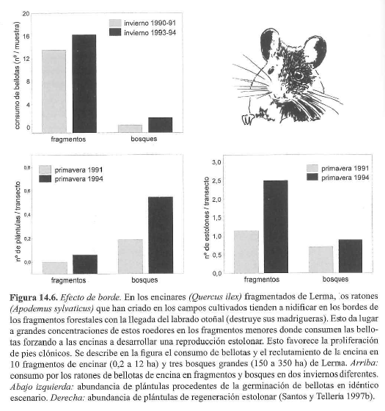
9. Edge Effect

Slide 48
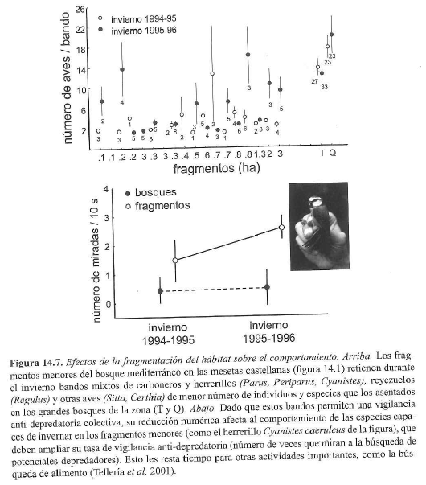
9. Edge Effect
Larger passerine bands in larger fragments and vice versa.
Smaller bands must change the use of space (to more protected places) and spend more time monitoring predators.

Slide 49
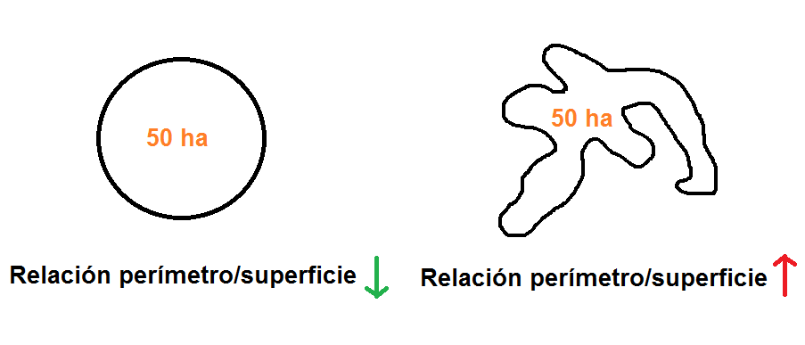
9. Edge Effect
Which shape in a fragment would be the most appropriate to mitigate the edge effect?
Perimeter/surface ratio
Perimeter/surface ratio

